Slide 1


Recommendations on Software and Service Citations from ESIP
Jessica.Hausman@jpl.nasa.gov, Jet Propulsion Laboratory, California Institute of Technology
Shelley Stall, American Geophysical Union
James Gallagher, OPeNDAP

Slide 2
Outline
Introduction of ESIP Software and Services Citations Cluster
Definition of software and services
Why cite software and services
Guidelines on citation format
Examples

Slide 3
Software and Services Citations Cluster
This cluster operates under the Earth Science Information Partners (ESIP) so that there can be collaboration with multiple organization
The cluster originally formed under NASA’s ESDSWG (Earth Science Data System Working Groups)
Made up of EOSDIS, DAACs, ROSES proposal winners and Subject Matter Experts
Started as DOIs for data, then data citations, then software and services
Sometimes users can only access the data via software or a tool or what happens when the tool manipulates the data? This question kept popping up so Software and Citations working group was formed

Slide 4
The goal was to make software and service citation format and landing pages specifically for NASA software and services
Did not consider models, on purpose
ESDSWG is closed, only its members can see the wiki or be on the email list
There are several other groups working on software citations
RDA, FORCE11, DataCite, Australia National Data Service,…
There is a need to collaborate with the different groups and address issues that are bigger than NASA’s current needs

Slide 5
Software vs. Services
Software – A computer program, in source code or compiled form, that supports scholarly research. Software may be downloaded, compiled, executed and instantiated.
E.g. models or anything on Github
Services – Services provide functions for the creation, access, processing and analysis of data. Services can be web services, provided across the web and following a well-defined machine protocol. In these guidelines software can be a service or web service. Services can be delivered through an implemented software instance that enables users to 'do' something with data. The user does not necessarily directly interact with the code.
E.g. Giovanni or processing on demand

Slide 6
Why Cite Software
To aid scientific reproducibility through direct, unambiguous reference to the precise software or service used in a particular study.
To provide fair credit for software developers or researchers who spend time in developing software. Citation of software also enables recognition of scholarly effort in disciplines and organizations what want to acknowledge and reward software development.
To ensure scientific transparency and reasonable accountability of research.
To aid in tracking the use and reuse of software through reference in scientific literature and within other software.
To help developers verify how their software are being used.
To make software FAIR (Findable Accessible Interoperable Reusable)

Slide 7
Guidelines
Developed from recommendations of ESIP data citations, FORCE11 Software Citation Working Group and DataCite Metadata Schema
Provides succinct citation format for the research scientist writing journal articles
The guidelines are currently going under review with the ESIP Assembly Members till mid January. Once approved they will be become an official ESIP product
Author. (Publication Year). Title. Version No. Publisher. PID URL. Access Date.

Slide 8
Examples
Has DOI
Xu, C., & Christoffersen, B. (2017). The Functionally-Assembled Terrestrial Ecosystem Simulator. Version 1. Los Alamos National Laboratory (LANL), Los Alamos, NM (United States). https://doi.org/10.11578/dc.20171025.1962. Accessed 2018-07-01.
Has DOI and in Github
McGibbney LJ, Reddy O, Jarif I, Spahn N, & Goodman A. (2018). nasa/podaacpy: Podaacpy v2.2.1 (Version 2.2.1). Zenodo. https://doi.org/10.5281/zenodo.1751973.

Slide 9
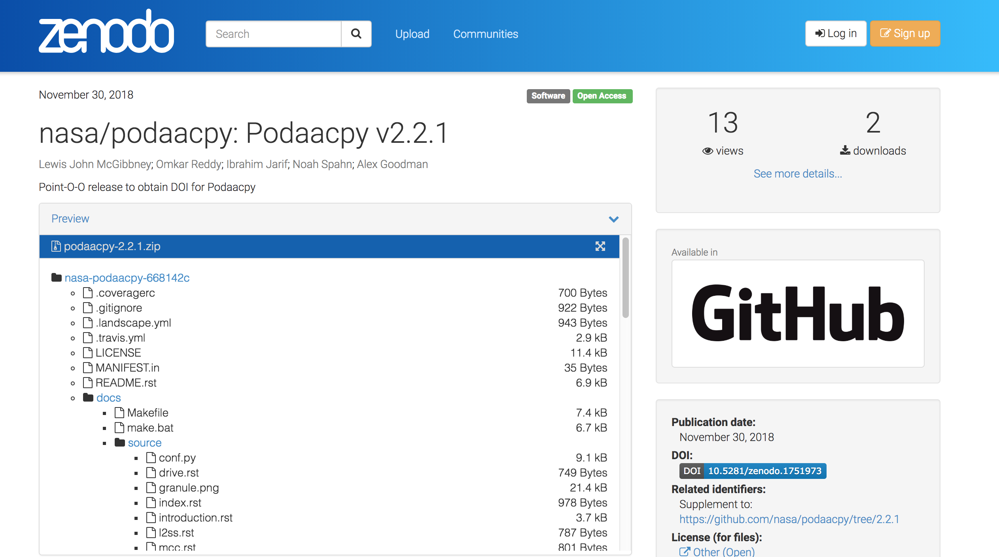

Slide 10
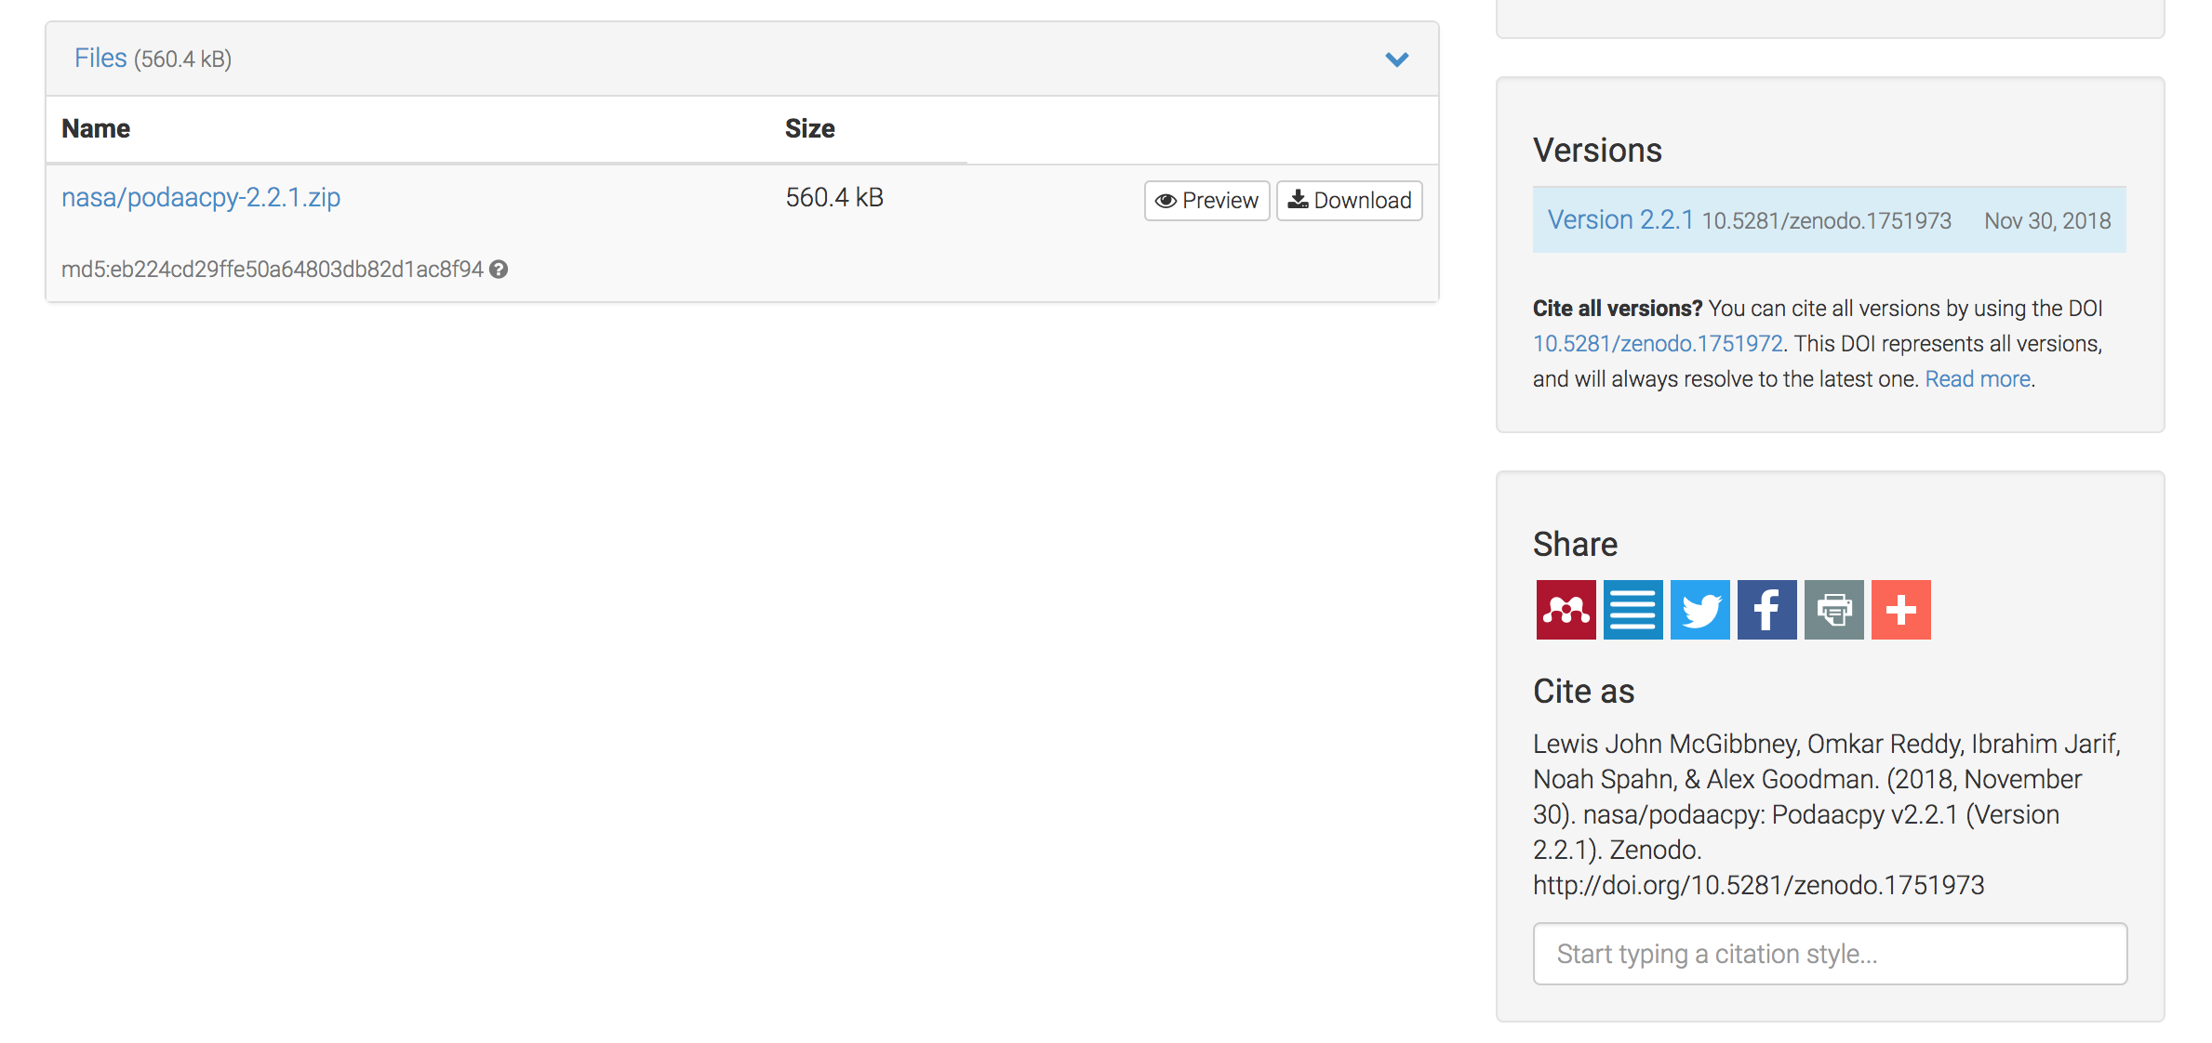

Slide 11
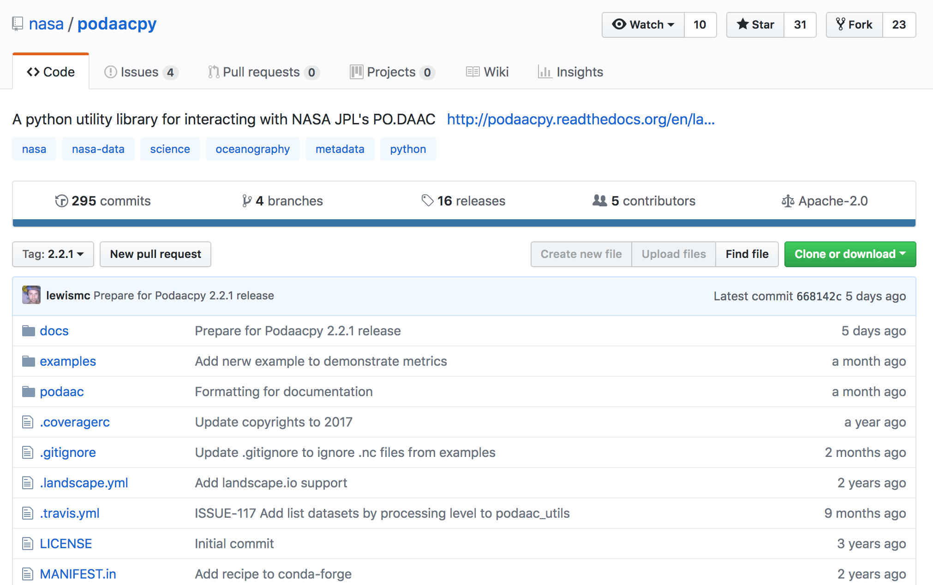

Slide 12
No DOI, must use URL
Jones E., Oliphant E., & Peterson P., et al. (2001). SciPy: Open Source Scientific Tools for Python. Version 1.1.0. Author. http://www.scipy.org/. Accessed 2018-07-26.
Giovanni Team. (2018). Giovanni. Ver. 4.28. Goddard, MD, USA. https://giovanni.gsfc.nasa.gov/giovanni. Accessed 2018-08-30.

Slide 13
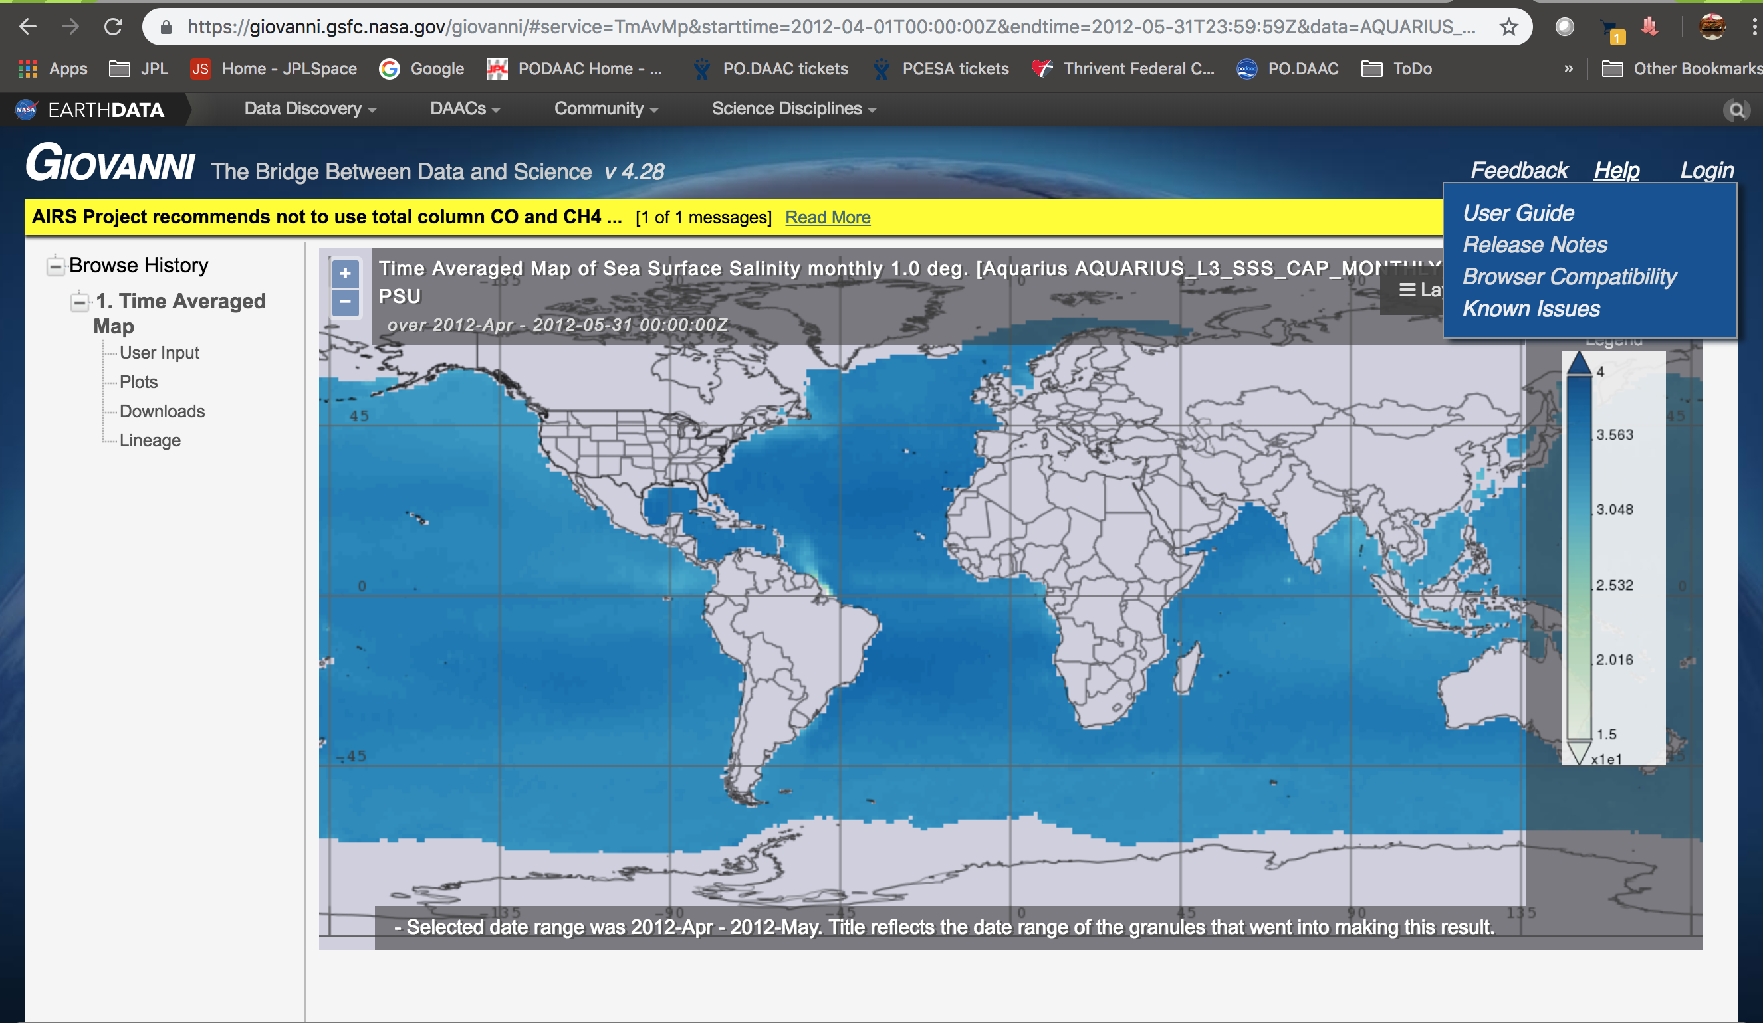

Slide 14
Conclusion
Guidelines will be made available from ESIP by early February
Consolidates recommendations from multiple working groups and organizations for the science researcher
FAIR software

Slide 15
Citation elements
Author(s) - the people or organizations responsible for the intellectual work to develop the software. Author(s) can be a list of individuals or a mission/project/group name.
Publication Year - when the software is published to a repository or any other publication venues. This is specific to the version being cited.
Title - the formal title of the software or service.
Version - the precise version of the software used. Careful version tracking is critical to accurate citation.
Publisher - the repository where software is held, archived, distributed, released or produced, ideally an institutional or disciplinary repository that provides curation and preservation of software. For example, Climate Data Gateway at NCAR, NASA Earth Exchange, Zenodo, Github (with Zenodo DOI), Figshare, Dataverse, Center for Open Science, Dryad.
Locator/Identifier - it should be a persistent identifier (PID) such as a DOI, Handle or ARK that resolves to landing page. DOI is considered best practice for software citation. DOIs are a unique, persistent identifier that can be used to track software citation metrics and to link related research outputs such as journal articles and research data.
Access Date [YYYY-MM-DD] - Ongoing development of software may not always be reflected in release dates and versions. It is important to indicate when software or a service was accessed, especially when no persistent identifier is used. At minimum include year and month.

